Slide 1
Nuclear Innovation Challenge
Controls &
Instrumentation:
Control Rod Simulator (Dye Control Regulator)
Group 9: Siddharth, Zhiyu, Cecilia, Issa, Kira

Slide 2
Dye Concentration Regulator
Challenge Problem :
For controller to regulate the same outputs within the limits of the existing physical constraints
Studying the flow, sensor accuracy, and system response
Physical System
(Reactor stability control)
State estimation and safety supervision
Comparing controllers over multiple tests, watching for “unsafe” conditions

Slide 3
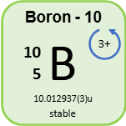
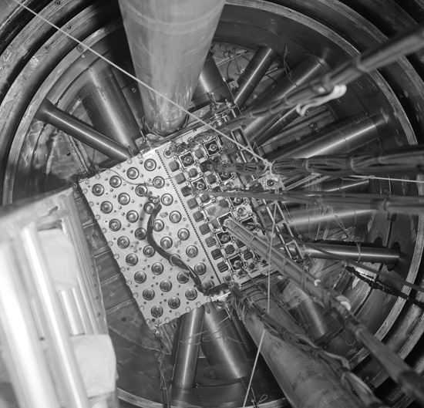
Relevance and Background
Relevance
  SMRs use boron in their control rods
    Controlling rate of reaction
  Helped in past nuclear disasters
  Too much boron, reactor shuts off
  Too little boron, no coolant
Impact
  Emergency shutdown (scram)
(Zoomie & Zoomie, 2024)

Slide 4
Control Rod Simulator
01
02
03
Reactor
Clear
Solution
Dyed
solution
  Starts as a clear solution
  Dyed solution slowly feeded in until ideal concentration
  Scram if no dye for too long
  No dye here is added.
  Feeds to reactor to dilute concentration when it’s too high
  Green Dye simulates boron in control rods
  Managing rate of reaction
  Highly concentrated
04
Waste Beaker
Used to pump solution from the reactor so that the reactor doesn’t exceed 450mL.

Slide 5
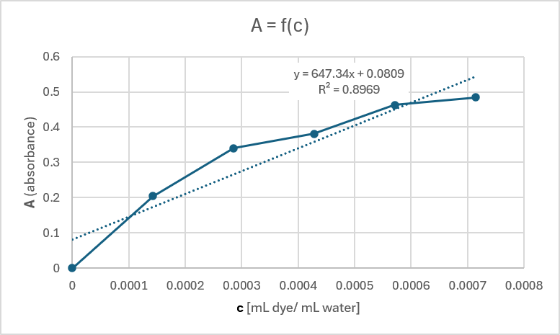
Pump Calibrations (Flow Rates) - false
Concentration Calibrations
Experiment and Observations
Waste: 9.4mL/s
Clear: 7.95mL/s
Dye: 8.9mL/s
  Got frequency from sensors
  Calculate absorbance from frequency, verify concentration
  Find absorbtion using Beer-Lambert’s law and measured frequency from light sensor
  Find concentration using:
c = (number of drops * 0.05ml) / 350ml
  Measured flow rates for calibration
  Created an app connected to the arduino, having separate buttons to control each flow
  Minimized external light
  Use camera sensors to measure water levels, to control the volume
  Testing the controller
Graph showing A, absorbance, depending on c, concentration of mL of dye per mL of water)

Slide 6
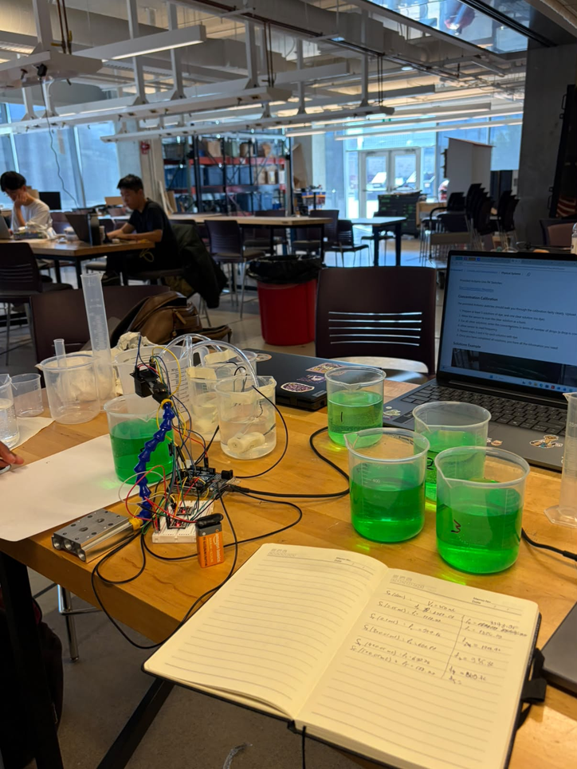
Setbacks
Concentration Calibration
External Light
  Wrong calibration and anomalous values because of the use of two identical solutions
  False usage of units
  Unnessary flow calibrations
  On second day, outside light became darker
  Moved to a brighter area
  Used cardboard box with incision for flashlight to minimize other light

Slide 7
Safety and Regulations
Managing concentration:
  Ability to slow or halt fission
  Disaster recognition
Stakeholder impact:
  Minimizing nuclear disasters
  Control rod lowering is automated - solution would not require further worker attention
Regulation alignment:
  Nuclear safety control act 2.1.10: neutron detector requirement
  Nuclear safety control act 2.2.5: neutron measurement system
(Government of Canada, Public Works and Government Services Canada, Public Services and Procurement Canada, Integrated Services Branch, Canada Gazette, 2025)
Notes:
https://gazette.gc.ca/rp-pr/p2/2025/2025-10-08/html/sor-dors196-eng.html
A.2.1.10 Neutron detectors
Especially designed or prepared neutron detectors for determining neutron flux levels within the core of a nuclear reactor within the meaning of paragraph A.2.1.1.
A.2.2.5 Neutron measurement systems for process control
Neutron measurement systems especially designed or prepared for integration and use with automated process control systems in reprocessing plants referred to in paragraph A.2.2.

Slide 8
Citations
Government of Canada, Public Works and Government Services Canada, Public Services
and Procurement Canada, Integrated Services Branch, Canada Gazette. (2025, October 9).
Canada Gazette, Part 2, Volume 159, Number 21: Regulations amending certain regulations made under the Nuclear Safety and Control Act (Imports, Exports and Safeguards). https://gazette.gc.ca/rp-pr/p2/2025/2025-10-08/html/sor-dors196-eng.html
Borates in nuclear energy: Preventive and emergency nuclear safety. (n.d.). https://www.borax.com/applications/nuclear-energy
Zoomie, & Zoomie. (2024, May 5). Control rods in nuclear reactors – it’s all about neutrons. Nevada Technical Associates, Inc. |. https://www.ntanet.net/control-rods-in-nuclear-reactors-its-all-about-neutrons/

Slide 9
AI Disclosure
AID Statement: Artificial Intelligence Tool: Claude (app, pro version); Conceptualization: Used to simplify some technical concepts mentioned in GitHub and explain in the simple way the functionality of the control rods in SMR; Execution: Modified and debugged the code used to run the Arduino to simulate the physical system of the dye concentration regulator; Visualization: Generated an app/dashboard Pump Control that gives commands to Arduino and is used to regulate the running pump tests, while adapting to the base dye concentration control. Generated the graph of concentration levels.

Slide 10

Thank You

